Slide 1
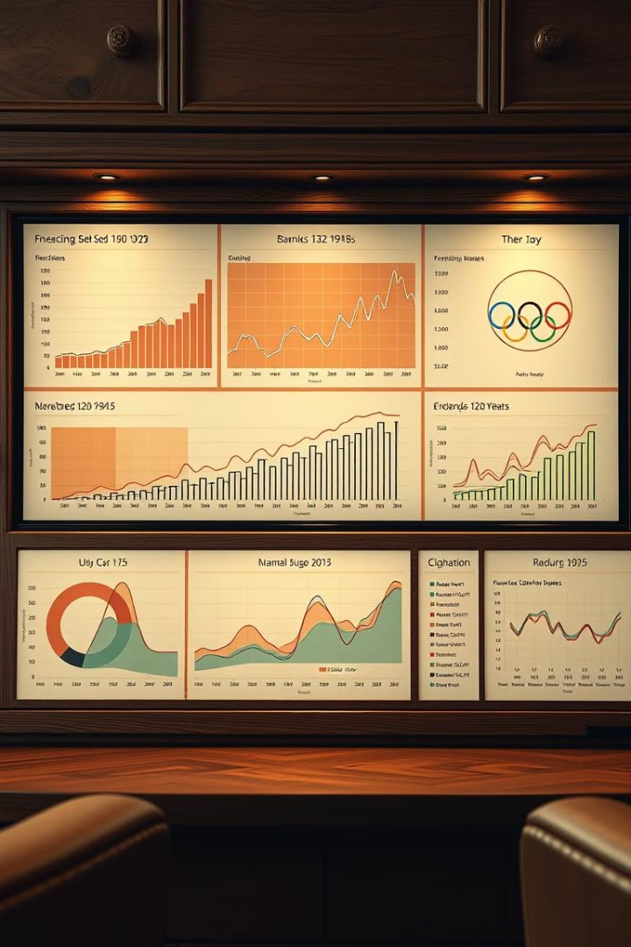
120 Years of Olympic Insights
This project analyze 120 years of Olympic data.
We built a Power BI dashboard to showcase key trends and insights.
Team members:
Abdelaziz Abdelfatah
Youssef Medhat
Shimaa Mostafa
Moataz Adel

Slide 2

Introduction to the Project and Dashboard
Data Sources
Dashboard Features
Maven Analytics 120 years of
Olympics dataset
Interactive charts, data visualizations, Story telling
Project Goal
To uncover significant trends in Olympic history.
Explore the achievements in the Olympic history by participants.
Examine the different countries that both held and participated in the Olympic games.

Slide 3
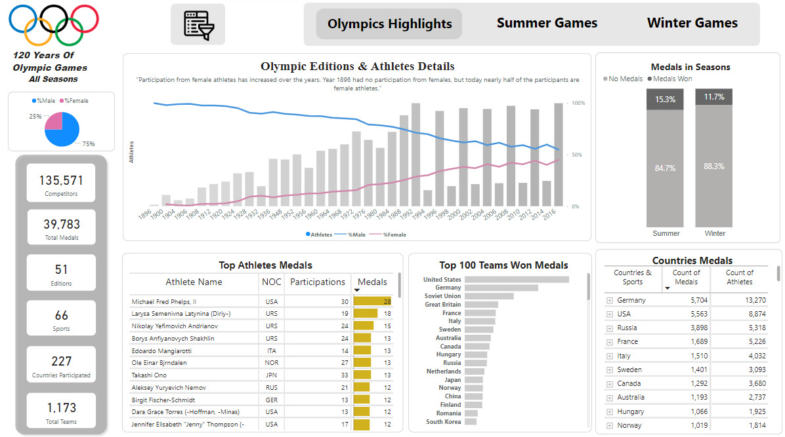
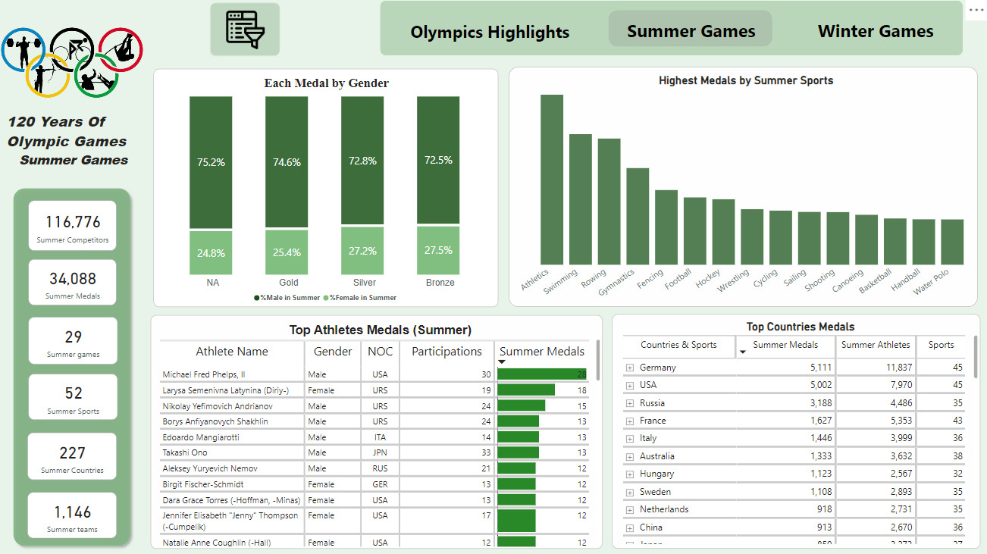

Visualizing the Data: Dashboards and Insights
The Highlight of Olympics
Games Graphs
A multitude of graphs that present Olympic changes
In detail graphs for the Summer and Winter Graphs

Slide 4
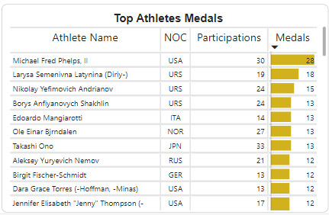
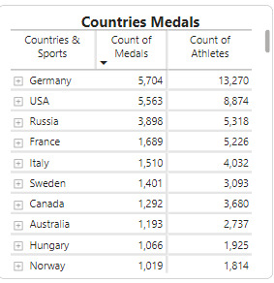
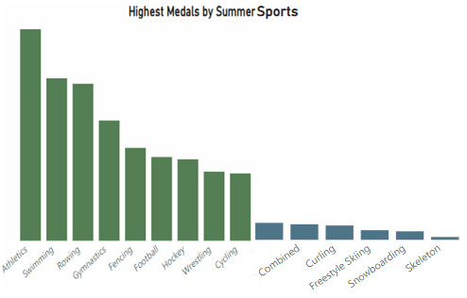
Medal Trends Across Countries and Events
Top Medal Winners
Emerging Nations
Event Dominance
Analysis of consistent top performers.
Identifying rising Nations in Olympic sports.
Analyzing trends in specific sports.

Slide 5
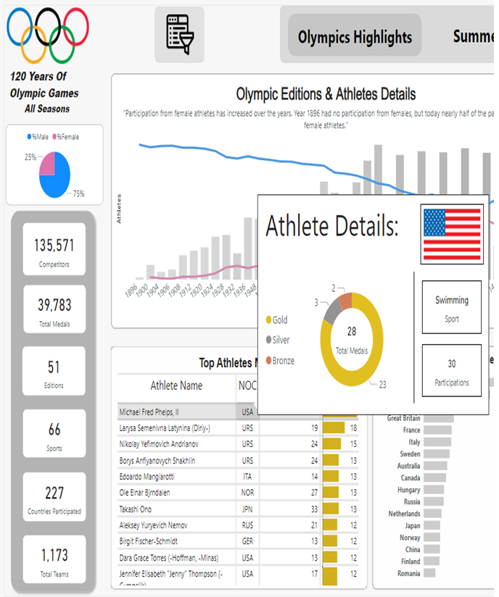



Dynamic data cards and insightful interactions
The main dashboard
Initial understanding of the data.
Interactive Data cards
Creating interactive dashboards.
Filtration options & Tool Tips
For better insights

Slide 6





Tools Used: Excel, and Power BI
Data Exploration
Excel for initial understanding of the data.
Data Cleaning
Excel for initial data cleaning.
Dashboard Creation
Power BI for interactive dashboards.

Slide 7
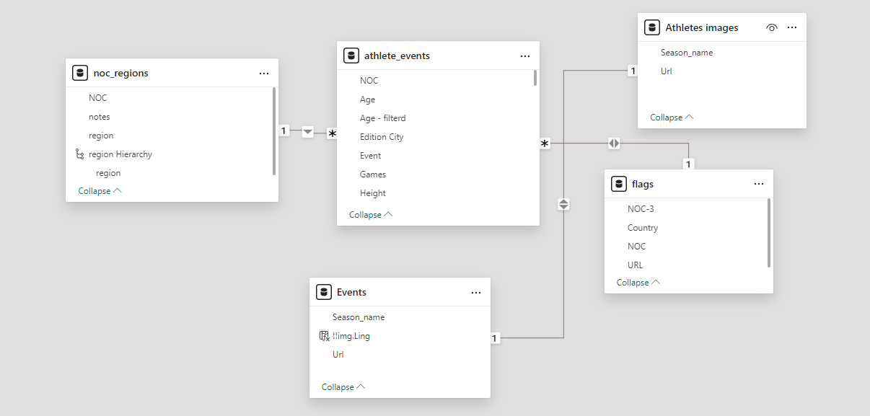
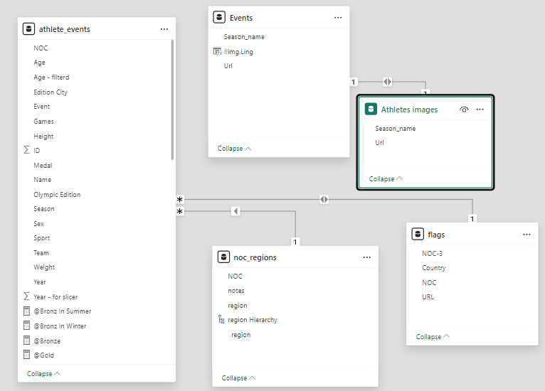
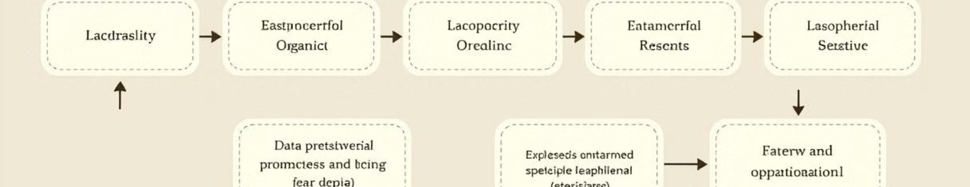

Data Preprocessing and Exploratory Data Analysis
Step
Description
Data Cleaning
Handling missing values and inconsistencies.
Data Transformation
Converting data into suitable formats.
Exploratory Analysis
Uncovering patterns, trends, and insights to inform better decision-making.

Slide 8
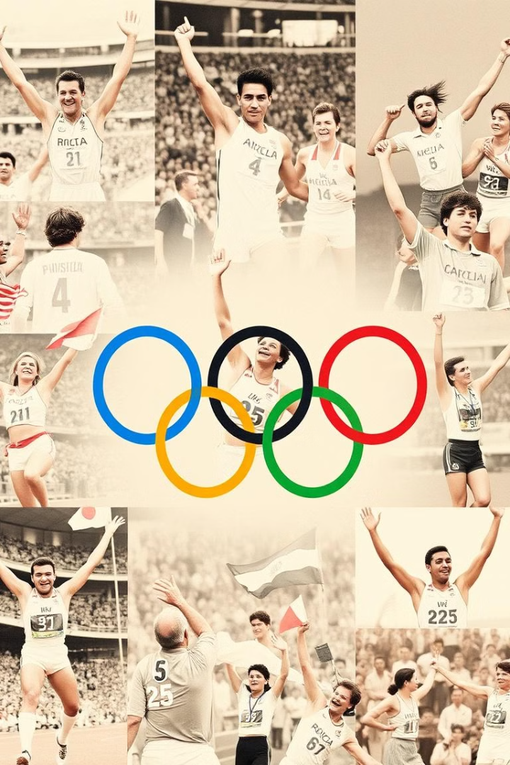
Key Insights
1
Growth Participation
2
Global Trends
The Olympics evolved from a simple European event to a World wide Event (14/200). Yet until now no Middle Eastern or North African country has ever host an Olympic event
During the Summer and Winter Olympics a various number was seen across nearly 6 : 1 in Participating Athletes Participating Countries
3
Gender Equality
Through the 120 years of Olympics a significant impact has been felt by female participant, there were no female participants until it reached almost 50% Male to 50% female participant around the 2016

Slide 9
Key Insights
4
Changes in Dominant Countries
5
Global Trends
6
Sports shifts with Popular trends
7
Impact of Geopolitics
8
Hosting Country Advantage

Slide 10

Recommendations
Data Improvements could be made through addition of Missing or Null values:
Adding Age field. Adding Weight and Height fields.
Adding a field to help show case the finical effect of being a hosting county.

Slide 11
Conclusion and Key Takeaways
Do you have any Questions ?!

